Slide 1
United College Of Engineering & Research Naini Prayagraj
PPT on Soft Computing
For CS/IT Vth Semester
Unit 1

Slide 2
Topics
Co(Course Outcomes) of Subject.
What is SC?
What is Neuron
Levels of Brain Organization
Types of Neurons
Biological Neurons
Artificial Neurons
Neural Signal Processing

Slide 3
Co(Course Outcomes) of Subject.
Co1 To devlop the skills to gain a basic understanding of neural network theory . Also explain the architecture of neural network, supervised & unsupervised learning.
Co2 To devlop the skills to gain the knowledge of various neural network models like perception model, single &multilayer model, back propagation model and its applications.
Co3 To understand the concept of fuzzy logic knowledge representation using fuzzy rules and fuzzy to crisp conversion.

Slide 4
Co(Course Outcomes) of Subject.
Co4 To devlop the knowledge of fuzzy membership & fuzzy rules and also their industrial applications.
Co5 To devlop the skills to gain a basic understanding of basic genetic algorithm techniques used in soft computing. Also some mutation generational cycle & its applications.

Slide 5
What is SC?
“Soft computing is a collection of methodologies that aim to exploit the tolerance for imprecision and uncertainty to achieve tractability, robustness, and low solution cost.
Its principal constituents are fuzzy logic, neurocomputing, and probabilistic reasoning. Soft computing is likely to play an increasingly important role in many application areas, including software engineering. The role model for soft computing
is the human mind.”

Slide 6
What is SC?
Soft computing is not precisely defined.
It consists of distinct concepts and techniques which aim to overcome the difficulties encountered in real world problems.
These problems result from the fact that our world seems to be imprecise, uncertain and difficult to categorize.
Possibly our world is uncertain really (see Quantum Theory, theory of relativity).
But question what is in reality and what is appeared in mind is senseless (R.A.Wilson, “Quantum Psychology”)

Slide 7
What is SC?
Another possible definition of soft computing is to consider it as an anti-thesis
to the concept of computer we now have, which can be described with all the adjectives such as hard, crisp, rigid, inflexible and stupid. Along this track,
one may see soft computing as an attempt to mimic natural creatures: plants, animals, human beings, which are soft, flexible, adaptive and clever. In this sense soft computing is the name of a family of problem-solving methods that have analogy with biological reasoning and problem solving (sometimes
referred to as cognitive computing).
The basic methods included in cognitive computing are fuzzy logic (FL),
neural networks (NN) and genetic algorithms (GA) - the methods which
do not derive from classical theories.

Slide 8
What is Soft Computing?
Soft Computing is a field that currently includes
Fuzzy Logic
Neural Networks
Probabilistic Reasoning(Genetic Algorithms, BBN), and
Other related methodologies
Case-Based Reasoning
Soft Computing combines knowledge, techniques, and methodologies from the sources above to create intelligent systems

Slide 9
What is covered in this class?
We will teach techniques useful in creating intelligent software systems that can deal with the uncertainty and imprecision of real world problems
Some components of Intelligent systems are
human-like - they possess human-like expertise within a specific domain,
adaptable - they adapt themselves and learn to do better in a changing environment, and
explanations - they explain how they make decisions or take actions

Slide 10
How will we teach the techniques?
We will present
multiple techniques from Soft Computing +,
when each technique is applicable
examples of industrial applications
“If the only tool you have is a hammer, then every problem looks like a nail”
- anonymous

Slide 11
Why is this important?
Farming
corn & cows
The information revolution going on is allowing us to automate information processing tasks which require intelligence much like the industrial revolution automated manufacturing tasks
“Soft Computing” techniques have already been applied successfully.
Industrial
Revolution
Manufacturing
chairs & cars
Information
Revolution
Service
content and code

Slide 12
Reasons of necessary of uncertainty in AI
Objective (features of whole environment)
Uncertainty of our world and limited capabilities of our senses
Subjective (features of interaction with concrete environment)
Different experience of different persons and peoples, in particular, it maps on features of semantics of different languages

Slide 13
Types of computing
Hard computing
Soft computing
Hard computing
1. It deals with precised models where accurate solutions are achieve quickly.
2. It is based based on mathematical approaches.
3. High degree of accuracy.
4. Hard Computing It deals with binary and crisp logic that need the precise input file consecutive. Hard computing isn’t capable of finding the real world problem’s solution.

Slide 14
Soft computing
It deals with appropriate model and gives appropriate solutions.
It is collection of A.I ,M.L , and some other engineering discipline.
Soft Computing could be a computing model evolved to resolve the non-linear issues that involve unsure, imprecise and approximate solutions of a tangle. These sorts of issues square measure thought of as real-life issues wherever the human-like intelligence is needed to resolve it.

Slide 15
Soft Computing vs Hard Computing:-
1. Soft Computing is tolerant of uncertainty, partial truth and approximation whereas Hard Computing requires a precisely state analytic model.
2. Soft Computing is based on fuzzy logic, neural sets, and probabilistic reasoning whereas Hard Computing is based on binary logic, crisp system, numerical analysis and crisp software.
3. Soft computing has the characteristics of approximation and dispositionality whereas Hard computing has the characteristics of precision and categoricity.
4. Soft computing can evolve its own programs whereas Hard computing requires programs to be written.

Slide 16
5. Soft computing can use multivalued or fuzzy logic whereas Hard computing uses two-valued logic.
6. Soft computing incorporates stochasticity whereas Hard computing is deterministic.
7. Soft computing can deal with ambiguous and noisy data whereas Hard computing requires exact input data.
8. Soft computing allows parallel computations whereas Hard computing is strictly sequential.
9. Soft computing can yield approximate answers whereas Hard computing produces precise answers.

Slide 17
Difference between Soft Computing and Hard Computing:
S.NO | SOFT COMPUTING | HARD COMPUTING
1. | Soft Computing is liberal of inexactness, uncertainty, partial truth and approximation. | Hard computing needs a exactly state analytic model.
2. | Soft Computing relies on formal logic and probabilistic reasoning. | Hard computing relies on binary logic and crisp system.
3. | Soft computing has the features of approximation and dispositionality. | Hard computing has the features of exactitude(precision) and categoricity.
4. | Soft computing is stochastic in nature. | Hard computing is deterministic in nature.
5. | Soft computing works on ambiguous and noisy data. | Hard computing works on exact data.

Slide 18
6. | Soft computing can perform parallel computations. | Hard computing performs sequential computations.
7. | Soft computing produces approximate results. | Hard computing produces precise results.
8. | Soft computing will emerge its own programs. | Hard computing requires programs to be written.
9. | Soft computing incorporates randomness . | Hard computing is settled.
10. | Soft computing will use multivalued logic. | Hard computing uses two-valued logic.

Slide 19
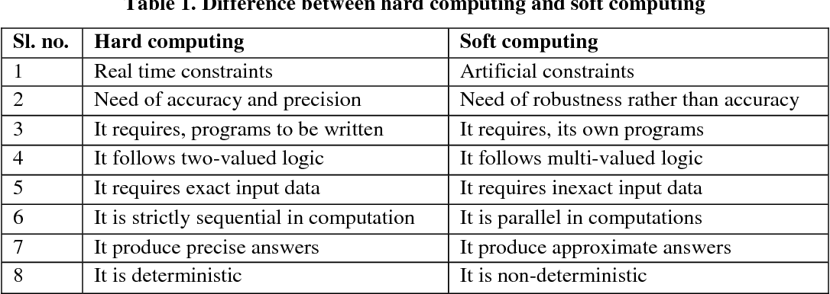

Slide 20
Application of soft computing
It is used in hand written recognition.
It is used in image processing.
It is used in data compression.
It is used in power system.
It is used in neuro fuzzy system.
It is used in fuzzy logic control.

Slide 21
Neuron
Cells within the nervous system, called neurons, communicate with each other in unique ways. The neuron is the basic working unit of the brain, a specialized cell designed to transmit information to other nerve cells, muscle, or gland cells.
The neuron is the basic building block of the nervous system
They are often grouped in bundles called nerves.

Slide 22
Neuron
The neuron is the basic working unit of the brain, a specialized cell designed to transmit information to other nerve cells, muscle, or gland cells.
Brain contains about 10¹⁰ basic unit called neurons and each neuron is connected about 10⁴ other neurons.
Neurons are also known as nerve cells.

Slide 23
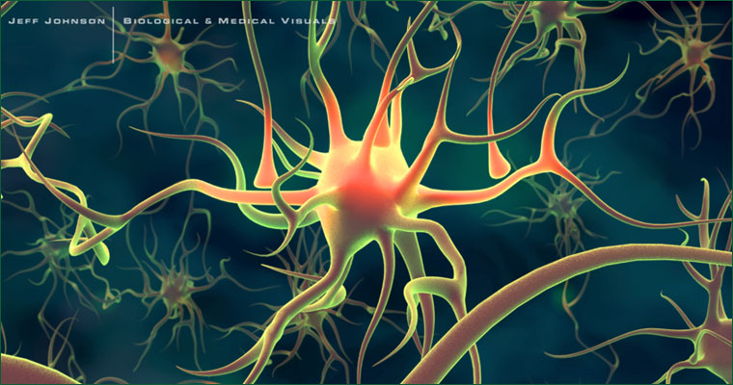

Slide 24
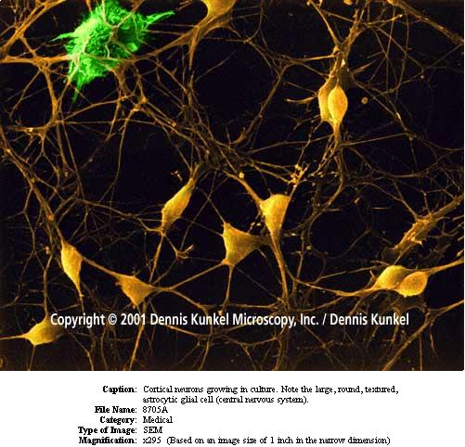

Slide 25
4 parts of the neuron
Dendrites are specialized to receive signals from neighboring neurons and carry them back to the cell body
Thin, bushy-like structures that receive information from outside the neuron
Relays the information into the cell body

Slide 26
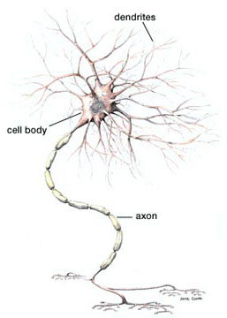
The Neuron
The Cell body contains the cell nucleus
The cell body relays the information down to the axon

Slide 27

The structure of a neuron
Axon: A thin, long structure that transmits signals from the cell body to the axon terminal.
Axon Terminal is the last step for the relay of information inside the neuron.

Slide 28

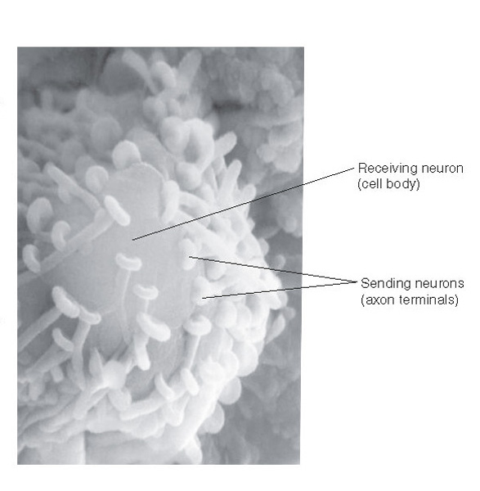
The cell body is covered with Axon Terminals

Slide 29
Once the information hits the terminal, it is transmitted outside the cell by neurotransmitters, which reside in the axon terminal.

Slide 30
Synaptic Transmission
The neurotransmitters are released from the vesicles and then attach to receptors located on the postsynaptic neuron.
These neurotransmitters are in contact with the dendrite of the postsynaptic neuron only briefly.
The chemical is almost immediately destroyed or reabsorbed
Notes:
This whole process takes 2 miliseconds

Slide 31
Neurotransmitters
At least 50 different types of neurotransmitters have been identified
Acetylcholine
GABA
Serotonin
Dopamine
Norepinephrine
Endorphins

